Slide 1
12_Storage classroom slides

Slide 2


My file

Slide 3
Directory
Directory
Directory
Files
Users
Eche’s music folder
Bruce Springsteen
Secret garden
Born to run
I’m on fire
Billy Joel
We didn’t start the fire
Piano Man
Uptown girl
Tupac Shakur
Changes
California love

Slide 4
File allocation schemes on the disk
Contiguous allocation
Contiguous allocation with overflow
Linked allocation
FAT
Indexed allocation
Multilevel indexed
Hybrid indexed

Slide 5
Figures of merit
Fast sequential access
Fast random access
Ability to grow the file
Easy allocation of storage
Efficiency of space utilization on the disk

Slide 6
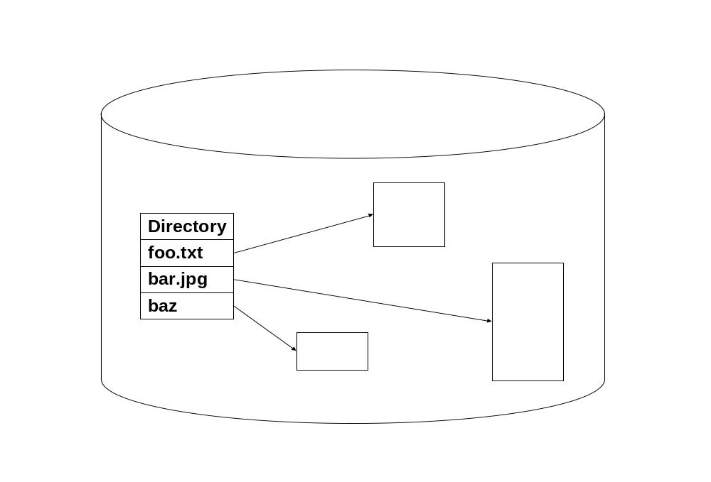
Contiguous allocation
medium
large
small

Slide 7
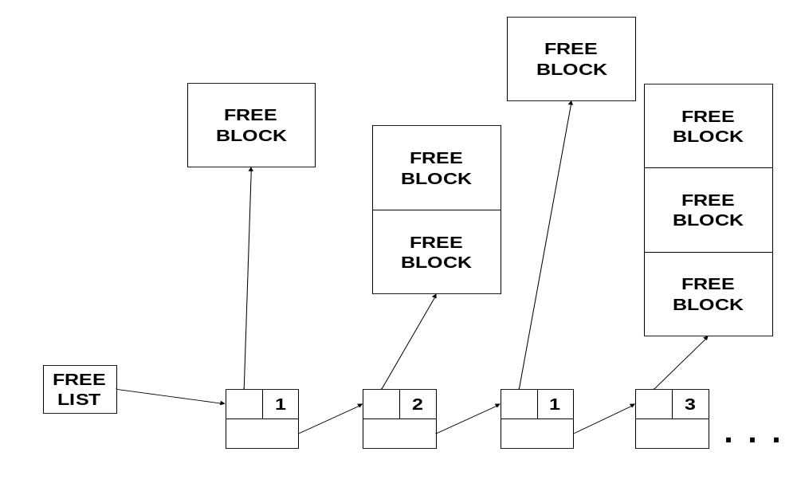
Free list for contiguous allocation

Slide 8
Cyl#, surf#, track#, sector#
File name disk address
Free list of disk blocks
/foo start addr
/bar start addr
………….
Name table

Slide 9
Linked List Allocation
Free list of sectors?
File name disk address
/foo 30
/bar 50
Name table

Slide 10
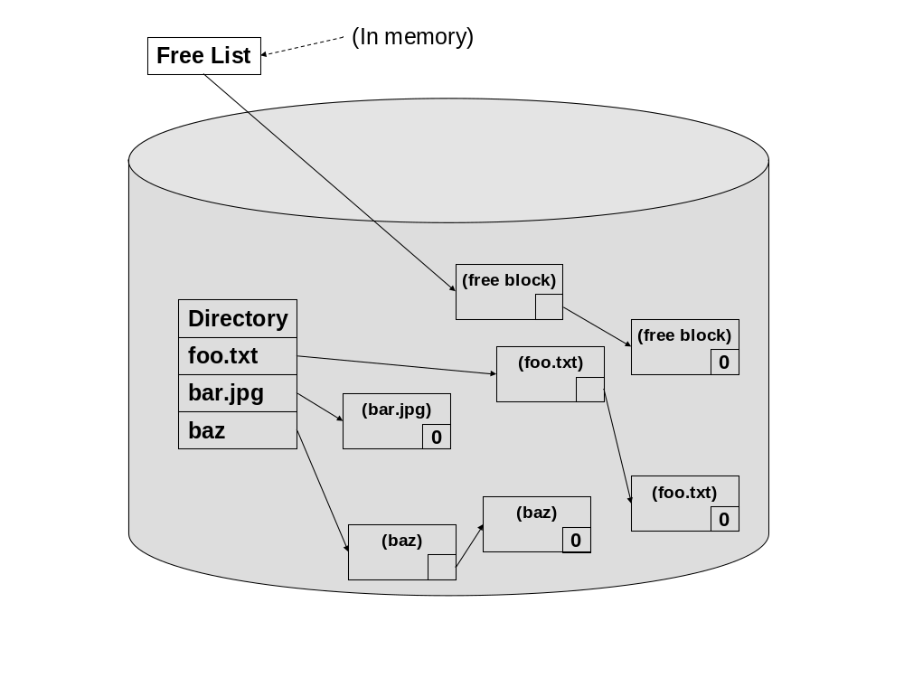
Linked allocation

Slide 11
File allocation table
Directory
FAT
0
0
0
File name start index
30
1
70
0
/foo 30
.
.
50
1
-1
/bar 50
0
.
.
70
1
-1
Free/busy next

Slide 12
Indexed allocation
Data blocks
Directory
i-node for /foo
100
30
File name i-node address
100
201
/ foo 30
201
/bar 50
i-node for /bar
50
99
99

Slide 13
Multilevel indexed allocation
Data blocks
Directory
100
i-node for /foo
1st level
File name i-node address
30
40
40
100
45
201
201
/foo 30
45
299
299

Slide 14
Hybrid indexed allocation
Data blocks
100
i-node for /foo
201
30
direct (100)
direct (201)
single indirect (40)
double indirect (45)
150
triple indirect
40
150
160
160
File
name
i-node
address
60
299
299
/foo 30
399
45
60
70
70
399
Directory

Slide 15
Allocation Strategy | File representation | Free list maintenance | Sequential Access | Random Access | File growth | Allocation Overhead | Space Efficiency
Contiguous | Contiguous blocks | complex | Very good | Very good | messy | Medium to high | Internal and external fragmentation
Contiguous With Overflow | Contiguous blocks for small files | complex | Very good for small files | Very good for small files | OK | Medium to high | - do -
Linked List | Non- contiguous blocks | Bit vector | Good but dependent on seek time | Not good | Very good | Small to medium | Excellent
FAT | - do - | FAT | - do - | Good but dependent on seek time | - do - | Small | - do -
Indexed | - do - | Bit vector | - do - | - do - | limited | Small | - do -
Multilevel Indexed | - do - | Bit vector | - do - | - do - | good | Small | - do -
Hybrid | - do - | Bit vector | - do - | - do - | good | Small | - do -

Slide 16
Example
Given the following:
Size of index block = 512 bytes
Size of Data block = 2048 bytes
Size of pointer = 8 bytes (to index or data blocks)
The i-node consists of
2 direct data block pointers,
1 single indirect pointer, and
1 double indirect pointer.
An index block is used for the i-node as well as for the index blocks that
store pointers to other index blocks and data blocks.
Note that the index blocks and data blocks are allocated on a need basis.
(a) What is the maximum size (in bytes) of a file that can be stored in this file system?
(b) How many data blocks are needed for storing the same data file of 266 KB?
(c) How many index blocks are needed for storing a data file of size 266 KB?

Slide 17
i-node
data
Direct Data pointer
Direct Data pointer
data
Single indirect pointer
index
data
Double indirect pointer
…
…
…
…
…
….
….
….
………
data
Pointers to
data blocks
…
…
…
data
…..
…
…
…
…
…
data
index
….
….
….
…
…
…
data
Pointers to index
blocks containing
single indirect
pointers
…..
data

Slide 18
Unix file system
/
users
students
staff
faculty
rama
foo

Slide 19
Attribute | Meaning | Elaboration
Name | Name of the file | Attribute set at the time of creation or renaming
Alias | Other names that exist for the same physical file | Attribute gets set when an alias is created; system such as Unix provide explicit commands for creating aliases for a given file; Unix supports aliasing at two different levels (physical or hard, and symbolic or soft)
Owner | Usually the user who created the file | Attribute gets set at the time of creation of a file; systems such as Unix provide mechanism for the file’s ownership to be changed by the superuser
Creation time | Time when the file was created first | Attribute gets set at the time a file is created or copied from some other place
Last write time | Time when the file was last written to | Attribute gets set at the time the file is written to or copied; in most file systems the creation time attribute is the same as the last write time attribute; Note that moving a file from one location to another preserves the creation time of the file
Privileges Read Write Execute | The permissions or access rights to the file specifies who can do what to the file; | Attribute gets set to default values at the time of creation of the file; usually, file systems provide commands to modify the privileges by the owner of the file; modern file systems such NTFS provide an access control list (ACL) to give different levels of access to different users
Size | Total space occupied on the file system | Attribute gets set every time the size changes due to modification to the file

Slide 20
i-node for /
i-node for /users/faculty
10
Type = directory
i-node for /users/faculty/rama
i-node for
/users/faculty/rama/foo
Type = directory
File
name
i-node
address
File
name
i-node
address
21
Type = directory
Type = data file
File
name
i-node
address
rama 21
30
direct (100)
users 5
direct (201)
mustaq 22
foo 30
single indirect (40)
double indirect (45)
leahy 23
triple indirect
i-node for /users
5
Type = directory
File
name
i-node
address
faculty 10
staff 11
i-node structure in Unix
students 12

Slide 21
i-node for
/users/faculty/rama/foo
i-node for /users/faculty/rama
21
Refcount = 1
Type = directory
Type = data file
File
name
i-node
address
30
direct (100)
direct (201)
foo 30
single indirect (40)
double indirect (45)
triple indirect
Reference count on files

Slide 22
i-node for
/users/faculty/rama/foo
/users/faculty/rama/bar
i-node for /users/faculty/rama
21
Refcount = 2
Type = directory
Type = data file
File
name
i-node
address
30
direct (100)
direct (201)
foo 30
single indirect (40)
double indirect (45)
bar 30
triple indirect
Hard links

Slide 23
i-node for
/users/faculty/rama/foo
/users/faculty/rama/bar
i-node for /users/faculty/rama
21
Refcount = 2
Type = directory
File
name
i-node address
Type = data file
30
direct (100)
foo 30
direct (201)
single indirect (40)
bar 30
double indirect (45)
baz 40
triple indirect
i-node for
/users/faculty/rama/baz
Refcount = 1
Type = sym link
40
/users/faculty/rama/foo
Sym links

Slide 24
After deleting foo and bar
i-node for /users/faculty/rama
21
Type = directory
File
name
i-node address
baz 40
i-node for
/users/faculty/rama/baz
Refcount = 1
Type = sym link
40
/users/faculty/rama/foo

Slide 25
Unix command | Semantics | Elaboration
touch <name> | Create a file with the name <name> | Creates a zero byte file with the name <name> and a creation time equal to the current wall clock time
mkdir <sub-dir> | Create a sub-directory <sub-dir> | The user must have write privilege to the current working directory (if <sub-dir> is a relative name) to be able to successfully execute this command
rm <name> | Remove (or delete) the file named <name> | Only the owner of the file (and/or superuser) can delete a file
rmdir <sub-dir> | Remove (or delete) the sub-directory named <sub-dir> | Only the owner of the <sub-dir> (and/or the superuse) can remove the named sub-directory
ln –s <orig> <new> | Create a name <new> and make it symbolically equivalent to the file <orig> | This is name equivalence only; so if the file <orig> is deleted, the storage associated with <orig> is reclaimed, and hence <new> will be a dangling reference to a non-existent file
ln <orig> <new> | Create a name <new> and make it physically equivalent to the file <orig> | Even if the file <orig> is deleted, the physical file remains accessible via the name <new>
chmod <rights> <name> | Change the access rights for the file <name> as specified in the mask <rights> | Only the owner of the file (and/or the superuser) can change the access rights
chown <user> <name> | Change the owner of the file <name> to be <user> | Only superuser can change the ownership of a file
chgrp <group> <name> | Change the group associated with the file <name> to be <group> | Only the owner of the file (and/or the superuser) can change the group associated with a file
cp <orig> <new> | Create a new file <new> that is a copy of the file <orig> | The copy is created in the same directory if <new> is a file name; if <new> is a directory name, then a copy with the same name <orig> is created in the directory <new>
mv <orig> <new> | Renames the file <orig> with the name <new> | Renaming happens in the same directory if <new> is a file name; if <new> is a directory name, then the file <orig> is moved into the directory <new> preserving its name <orig>
cat/more/less <name> | View the file contents

Slide 26
Examples in book
Work out examples for i-node creation and deletion
in book on your Own:
Examples 5, 6, and 7

Slide 27
Layers of the file system
User program
OS
API Module
Name
resolver
Media independent
layer
Storage Space
allocation
module
Media specific
storage space
allocation layer
Media specific device driver for
data transfer, and Interrupt processing;
Device
driver
Media specific
Request scheduling layer
Disk scheduling
algorithm

Slide 28
User program
User program
PCB₁
PCB₂
CPU scheduler
FS Manager
VM Manager
ready_q
…
PCB₁
PCB₂
device driver
device driver
Disk scheduler
Flash drive scheduler
Disk Controller
Controller
Disk
Flash drive

Slide 29
User program
User program
PCB₁
PCB₂
CPU scheduler
FS Manager
VM Manager
ready_q
PCB₂
…
device driver
device driver
Disk_IO_q
PCB₁
Disk scheduler
Flash drive scheduler
Disk Controller
Controller
Disk
Flash drive

Slide 30
User program
User program
PCB₁
PCB₂
CPU scheduler
FS Manager
VM Manager
ready_q
PCB₂
…
device driver
device driver
Disk_IO_q
PCB₁
Disk scheduler
Flash drive scheduler
Disk Controller
Controller
Disk
Flash drive

Slide 31
User program
User program
PCB₁
PCB₂
CPU scheduler
FS Manager
VM Manager
ready_q
…
PCB₂
PCB₁
device driver
device driver
Disk scheduler
Flash drive scheduler
Disk Controller
Controller
Disk
Flash drive

Slide 32
Layout of contents on disk
Data structure for
MBR
Partition
Table
Well known
location
MBR
Disk
Partition
Disk
Partition
Disk
Partition
{platter 0,
track 0,
sector 0}

Slide 33
Partition table
Partition | Start address {platter, track, sector} | End address {platter, track, sector} | OS
1 | {1, 10, 0} | {1, 600, 0} | Linux
2 | {1, 601, 0} | {1, 2000, 0} | MS Vista
3 | {1, 2001, 0} | {1, 5000, 0} | None
4 | {2, 10, 0} | {2, 2000, 0} | None
5 | {2, 2001, 0} | {2, 3000, 0} | None

Slide 34
Each partition
Superblock
Storage management Data structures
Per-file
Information
Boot
block
Root of the
file system
Data and directory files

Slide 35

Example: ext2
i-node number
length of entry
entry type
length of name
name
padding
Four fixed-length fields
Variable length field
i-node entry in a directory file
52788
32
F
22
i_like_file_names_long
padding
4 1 1 1 22 3
A specific i-node
Entry for datafile
Entry for another_datafile
Entry for my_subdirectory
Multiple entries in the directory file
Entry for datafile
Entry for my_subdirectory
After deletion of middle entry

Slide 36
Permissions and administrative information
data
data
Single indirect
Pointers to 12 direct data blocks
data
…..
…
…
…
…..
Single indirect pointer
data
…
…
…
data
Double indirect
…..
Double indirect pointer
…
…
…
data
….
…
…
…
data
Triple indirect pointer
…..
data
…
…
…
…
…
…
data
i-node
Triple indirect
….
….
…
…
…
….
….
….
….
….
….
…
…
…
…
…
…
….
….
data

Slide 37
Journaling FS: ext3
File name = X
Data block = d_{X}
New Contents = c_{X}
File name = Y
Data block = d_{Y}
New Contents = c_{Y}
File name = Z
Data block = d_{Z}
New Contents = c_{Z}
Log record for changes
to file X
Log record for changes
to file Y
Log record for changes
to file Z

Slide 38
Microsoft NTFS
File name and other standard attributes
File size = 13
Cluster address = 64
Size = 4
Cluster address = 256
Size = 8
Cluster address = 408
Size = 1
MFT (master file table) entry in NTFS

